Slide 1
Universality Class
LEE SungBin

Slide 2
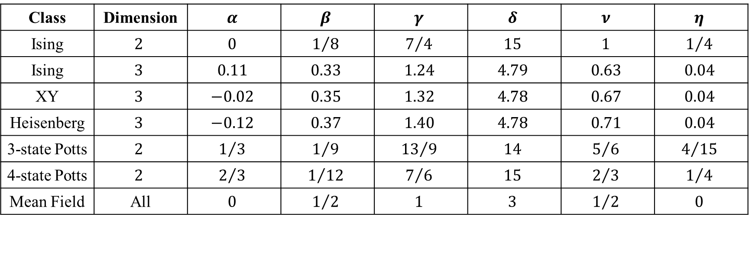
Critical Exponents
Class | Dimension | $$α$$ | $$β$$ | $$γ$$ | $$δ$$ | $$ν$$ | $$η$$
Ising | $$2$$ | $$0$$ | $$1/8$$ | $$7/4$$ | $$15$$ | $$1$$ | $$1/4$$
Ising | $$3$$ | $$0.11$$ | $$0.33$$ | $$1.24$$ | $$4.79$$ | $$0.63$$ | $$0.04$$
XY | $$3$$ | $$−0.02$$ | $$0.35$$ | $$1.32$$ | $$4.78$$ | $$0.67$$ | $$0.04$$
Heisenberg | $$3$$ | $$−0.12$$ | $$0.37$$ | $$1.40$$ | $$4.78$$ | $$0.71$$ | $$0.04$$
3-state Potts | $$2$$ | $$1/3$$ | $$1/9$$ | $${13}/9$$ | $$14$$ | $$5/6$$ | $$4/{15}$$
4-state Potts | $$2$$ | $$2/3$$ | $$1/{12}$$ | $$7/6$$ | $$15$$ | $$2/3$$ | $$1/4$$
Mean Field | All | $$0$$ | $$1/2$$ | $$1$$ | $$3$$ | $$1/2$$ | $$0$$

Slide 3
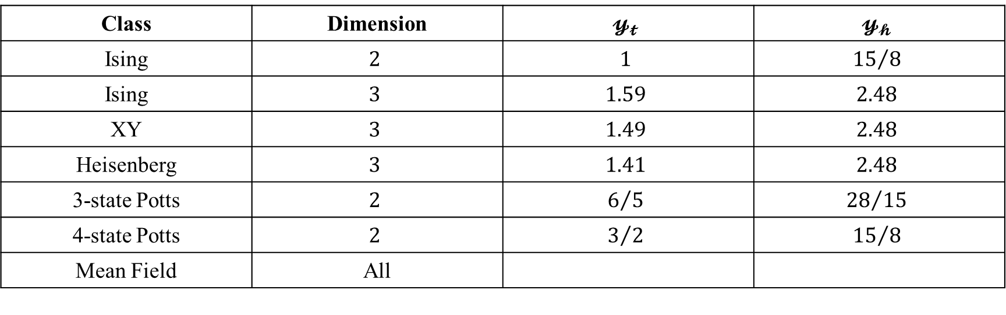
Renormalization Group
Class | Dimension | $$𝔂_{𝓽}$$ | $$𝔂_{𝓱}$$
Ising | $$2$$ | $$1$$ | $${15}/8$$
Ising | $$3$$ | $$1.59$$ | $$2.48$$
XY | $$3$$ | $$1.49$$ | $$2.48$$
Heisenberg | $$3$$ | $$1.41$$ | $$2.48$$
3-state Potts | $$2$$ | $$6/5$$ | $${28}/{15}$$
4-state Potts | $$2$$ | $$3/2$$ | $${15}/8$$
Mean Field | All

Slide 4
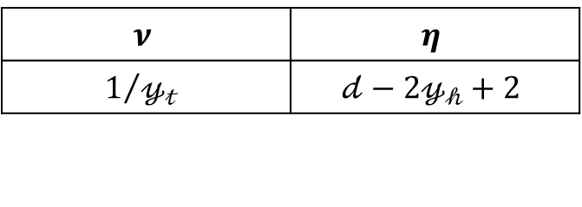
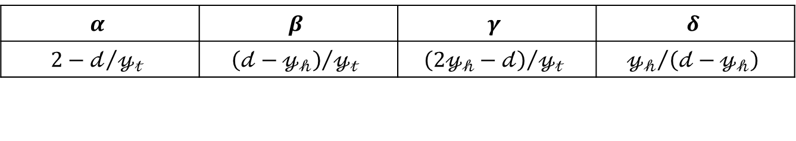
Scaling Relations
$$α$$ | $$β$$ | $$γ$$ | $$δ$$
$$2−𝒹/{𝓎_{𝓉}}$$ | $${\left(𝒹−𝓎_{𝒽}\right)}/{𝓎_{𝓉}}$$ | $${\left(2𝓎_{𝒽}−𝒹\right)}/{𝓎_{𝓉}}$$ | $${𝓎_{𝒽}}/{\left(𝒹−𝓎_{𝒽}\right)}$$
$$ν$$ | $$η$$
$$1/{𝓎_{𝓉}}$$ | $$𝒹−2𝓎_{𝒽}+2$$

Slide 5
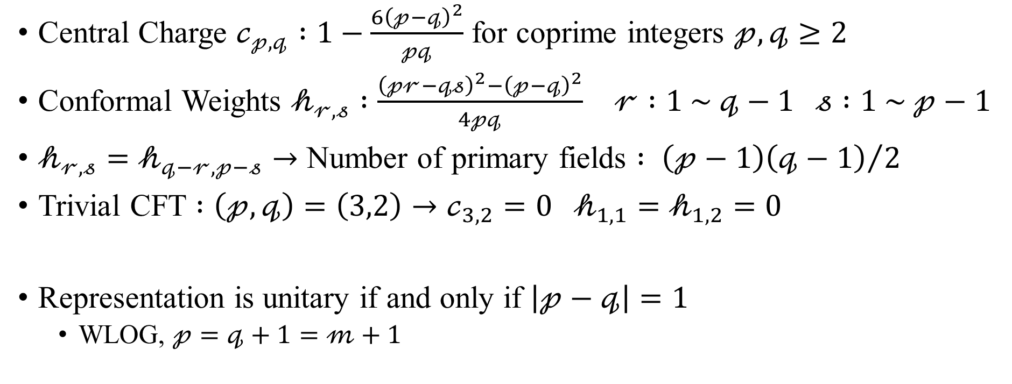
Representation of Virasoro Algebra
Central Charge $𝒸_{𝓅,𝓆} :1−\frac{6{\left(𝓅−𝓆\right)}^{2}}{𝓅𝓆}$ for coprime integers $𝓅,𝓆≥2$
Conformal Weights $𝒽_{𝓇,𝓈} :\frac{{\left(𝓅𝓇−𝓆𝓈\right)}^{2}−{\left(𝓅−𝓆\right)}^{2}}{4𝓅𝓆}$ $𝓇 :1 \sim 𝓆−1 𝓈 :1 \sim 𝓅−1$
$𝒽_{𝓇,𝓈}=𝒽_{𝓆−𝓇,𝓅−𝓈}→$ Number of primary fields $: {\left(𝓅−1\right)\left(𝓆−1\right)}/2$
Trivial CFT $:\left(𝓅,𝓆\right)=\left(3,2\right)→𝒸_{3,2}=0 𝒽_{1,1}=𝒽_{1,2}=0$
Representation is unitary if and only if $\left|𝓅−𝓆\right|=1$
WLOG, $𝓅=𝓆+1=𝓂+1$

Slide 6
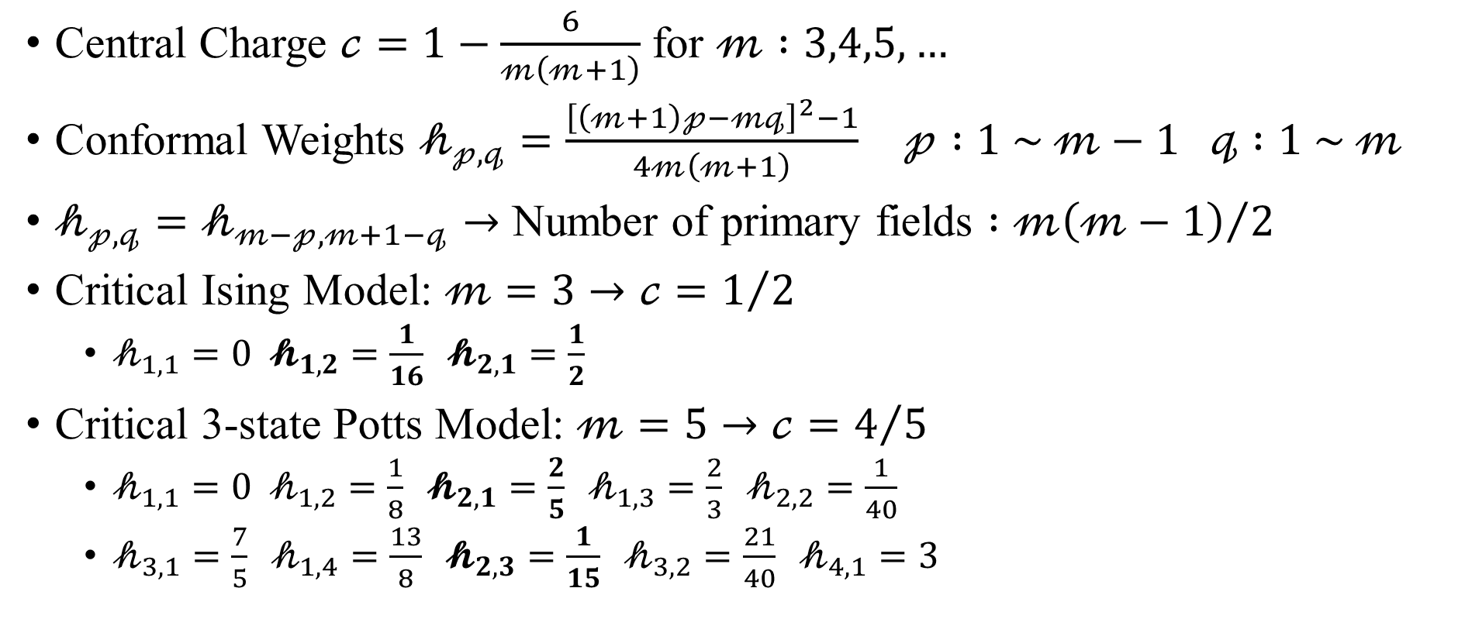
Unitary Representation of Virasoro Algebra
Central Charge $𝒸=1−\frac{6}{𝓂\left(𝓂+1\right)}$ for $𝓂 :3,4,5,…$
Conformal Weights $𝒽_{𝓅,𝓆}=\frac{{\left[\left(𝓂+1\right)𝓅−𝓂𝓆\right]}^{2}−1}{4𝓂\left(𝓂+1\right)}$ $𝓅 :1 \sim 𝓂−1 𝓆 :1 \sim 𝓂$
$𝒽_{𝓅,𝓆}=𝒽_{𝓂−𝓅,𝓂+1−𝓆}→$ Number of primary fields $:{𝓂\left(𝓂−1\right)}/2$
Critical Ising Model: $𝓂=3→𝒸=1/2$
$𝒽_{1,1}=0 𝓱_{1,2}=\frac{1}{16} 𝓱_{2,1}=\frac{1}{2}$
Critical 3-state Potts Model: $𝓂=5→𝒸=4/5$
$𝒽_{1,1}=0 𝒽_{1,2}=\frac{1}{8} 𝓱_{2,1}=\frac{2}{5} 𝒽_{1,3}=\frac{2}{3} 𝒽_{2,2}=\frac{1}{40}$
$𝒽_{3,1}=\frac{7}{5} 𝒽_{1,4}=\frac{13}{8} 𝓱_{2,3}=\frac{1}{15} 𝒽_{3,2}=\frac{21}{40} 𝒽_{4,1}=3$

